Slide 1
DATA 598A - Replication Project
Modeling the Non-linear Effect of Temperature on Economic Production [1]
Advika Battini, Iacopo Garizio, James Lee, Bianca Zlavog
URL: https://github.com/UW-MSDS-DATA-598-Reproducibility-WI20/battini-garizio-lee-zlavog-replication-project
[1]: Burke, M., Hsiang, S. & Miguel, E. Global non-linear effect of temperature on economic production. Nature 527, 235–239 (2015). https://doi.org/10.1038/nature15725
Notes:
Update your project to respond to the peer reviews, and document your updates in the GitHub issue tracker. Then please prepare a 5-7 minute presentation to share your replication project with the class. In your presentation you need 5-7 slides as follows:

Slide 2
Target Paper Summary
This paper examines the effect of temperature on economic production in terms of GDP per capita
Findings suggest that overall economic productivity is non-linear in temperature globally, and declines strongly at higher temperatures
Weak evidence that richer populations are less vulnerable to warming, and that the accumulation of wealth, technology and experience might not significantly mitigate global economic losses during this century
Why was this paper chosen?
The paper was chosen as it aims to model the role of wealth in coupled human-natural systems and anticipates the global economic impact of climate change
The paper is very well-documented with detailed code and data to reproduce the study
Notes:
The chosen article, (Burke, Hsiang, and Miguel 2015), seeks to model the relationship between gross domestic product per capita and climate change. Discover a non-linear relationship between climate variables such as temperature and precipitation with economic growth, The relationship is remains unchanged since 1960, and is apparent in both rich and poor countries. The authors predict a 23% decrease in global economic output by 2100 given “business-as-usual” emissions scenarios, relative to forecasts without climate change. Also of interest is the disproportionate negative economic impacts on lower-income countries which are typically warmer, compared to high-income countries which have lower temperatures; the authors predict slight economic gains for the wealthiest 20% of countries, in contrast with decreases of 75% for the poorest 40% of countries.
Why?
There are two reasons on why we chose this paper. First, the paper was interesting in comparing the current economic status of multiple countries based on climate, and then comparing the same status with the expectation of increased temperature without proper climate control. Second, the paper is very well-documented. The authors had left detailed step by step instructions, the code and the data to reproduce the study.

Slide 3

Briefly describe your target paper and why you chose it
Paper Replication Repository
Notes:
The paper had sufficient documentation to replicate. The authors had left the data and code with step by step instructions in a read.me file to generate the file. The paper served as a model of a fully reproducible paper that an individual, given the right programs and tools, can follow along to achieve the same results as the authors.
Detailed instructions include,
The versions of the programs used,
Information on the file/folder structures,
Step by step instructions on replicating each result and figures visualized on paper.

Slide 4
Key Scientific Claims
Non-linear, concave relationship between global temperatures and change in GDP per capita, with productivity peaking at an annual average temperature of 13 ℃
Distinction between impact of climate change on GDP per capita in rich and poor economies, to check for widening income inequality
Unmitigated warming is expected to decrease global incomes by 23% by 2100
Notes:
The following analysis replicates figures 2 and 3 from the paper. The first of these depicts the non-linear relationship between global temperatures and change in gross domestic product per capita, with incomes peaking around 13 degrees Celsius. This figure also points out where some of the major countries are located on this curve, and how population and economic output are distributed at various levels of temperature. The figure also depicts the above-mentioned relationship for rich and poor countries. Countries with GDP less than the 50th percentile are grouped in the poor bracket.
Are wealth and human-made capital are substitutes for natural capital (for example, the composition of the atmosphere) in economic activity?

Slide 5
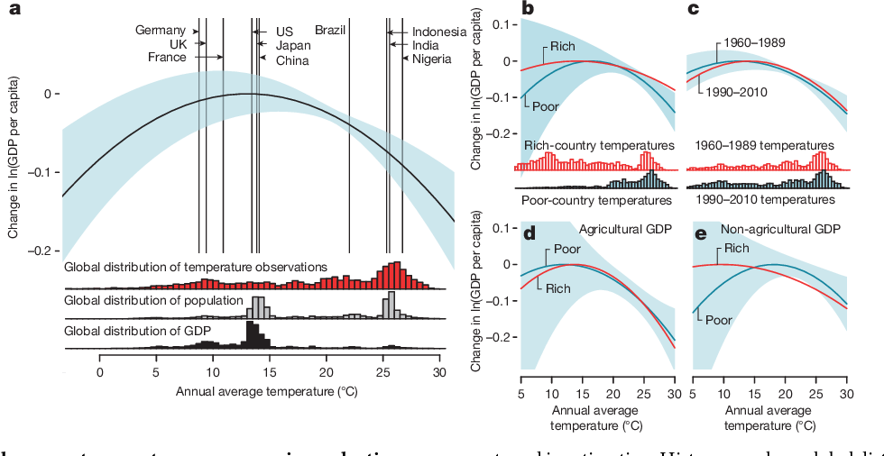
Target Paper Figures
Notes:
The authors show that there is a nonlinear concave relationship for agricultural and non-agricultural production with temperature for both rich and poor countries. Peak productivity is attained at 13 degrees Celsius average annual temperature, around which many high-income countries are clustered, whereas many developing countries are associated with higher temperatures and higher productivity losses from temperature increases.
Effect of annual average temperature on economic production. a, Global non-linear relationship between annual average temperature and change in log gross domestic product (GDP) per capita (thick black line, relative to optimum) during 1960–2010 with 90% confidence interval (blue, clustered by country, N 5 6,584). Model includes country fixed effects, flexible trends, and precipitation controls. Vertical lines indicate average temperature for selected countries, although averages are not used in estimation. Histograms show global distribution of temperature exposure (red), population (grey), and income (black). b, Comparing rich (above median, red) and poor (below median, blue) countries. Blue shaded region is 90% confidence interval for poor countries. Histograms show distribution of country–year observations. c, Same as b but for early (1960– 1989) and late (1990–2010) subsamples (all countries). d, Same as b but for agricultural income. e, Same as b but for non-agricultural income.

Slide 6
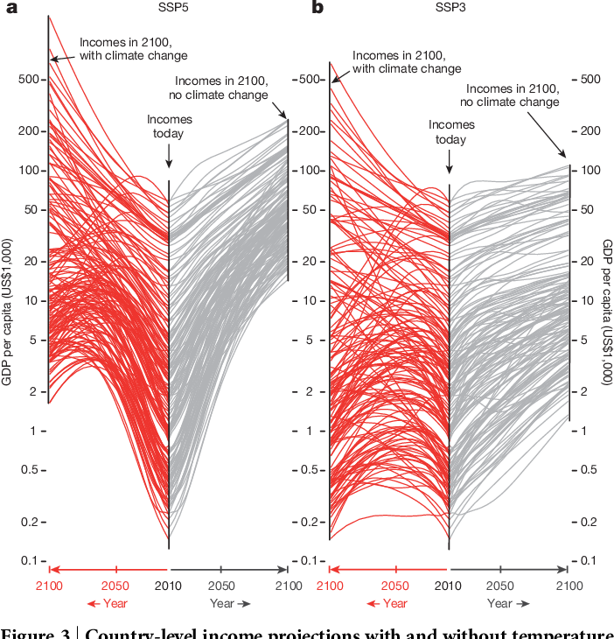
Target Paper Figures
Notes:
Country-level income projections with and without temperature effects of climate change. a, b, Projections to 2100 for two socioeconomic scenarios consistent with RCP8.5 ‘business as usual’ climate change: a, SSP5 assumes high baseline growth and fast income convergence; b, SSP3 assumes low baseline growth and slow convergence. Centre in each panel is 2010, each line is a projection of national income. Right (grey) are incomes under baseline SSP assumptions, left (red) are incomes accounting for non-linear effects of projected warming.

Slide 7
Highlights of the Replication Effort
Divergence from original study
The paper groups countries as rich and poor based on the 50th percentile of GDP at purchasing power parity (PPP). We used the World Bank (2019) classifications of “low income” and “upper middle income” to recalculate the percentile that defines poor countries. The new percentile used is 42.
While modeling, the authors use a seed for each bootstrap regression. To verify that the seed was not causing the process to generate non-representative results, we changed it to a new value.
Notes:
Country classification definition
The paper, being consistent with “Climate change and economic growth: evidence from the last half century” (Dell, Jones, and Olken 2008), groups countries as rich and poor based on the 50th percentile of GDP at purchasing power parity (PPP). The implication of this classification has some effect on the assumptions the paper makes, so we will use an income classification threshold based on World Bank data (Bank 2019). We used the World Bank classifications of “low income” and “upper middle income” to recalculate the percentile that defines poor countries. The new percentile calculated is 42.
Given the similar curves of GDP per capita in response to a change in annual average temperatures for rich and poor countries, this change should not have a high impact on the main conclusions of the paper.
Bootstrap randomization
To replicate the same figures from the paper, the author uses a seed for each bootstrap regression. To verify that the seed was not causing the process to generate non-representative results, we changed it to a new value. In a robust and well-performed simulation and estimation, the seed chosen should not have a noticeable impact on the conclusions.

Slide 8
Reflections on the Process
Key Challenges
The analysis uses STATA and R. Since STATA needs a license, we added the generated output to our repository so it has the option to run without STATA
Output data was too large and needed to be trimmed for github (part of the commit history)
Some libraries were deprecated and had to be replaced to maintain identical functionality
The code was not well commented and had significant parts hardcoded and repeated
Group Member Major Contributions
Bianca Zlavog | R and Stata output generation, Created .Rmd to automate the pipeline and generate the word doc, and incorporated Stata code into .Rmd
James Lee | Set up a Project file and applied here and pacman packages to set up efficient, and easy to load file-paths and package requirements in code.
Iacopo Garizio | Helped set-up R code, researched possible changes to introduce to the code, and helped to implement them.
Advika Battini | Stata output generation, Debugged and set-up R code, Created .Rmd to automate the pipeline and generate the word doc, presentation outline
Notes:
Bianca Zlavog: R and Stata output generation, Created .Rmd to automate the pipeline and generate the word doc, and incorporated Stata code into .Rmd
James Lee: Set up a Project file and applied here and pacman packages to set up efficient, and easy to load file-paths and package requirements in code.
Iacopo Garizio: Helped set-up R code, researched possible changes to introduce to the code, and helped to implement them.
Advika Battini: STATA output generation, Debugged and set-up R code, Created .Rmd to automate the pipeline and generate the word doc, presentation outline

